Slide 1





EDA ON NETFLIX MOVIES & TV SHOWS DATASET
By: Ayanka Ghosh
Guide Name: Ms. Naina Devi

Slide 2



AGENDA
OF THE PROJECT
Introduction
Tools & Technologies
Project Working
Output & Insights
Applications
Challenges & Solutions
Future Scope
Project Link
To analyze the Netflix Movies & TV Shows dataset
To understand the content trends over the years
To compare Movies vs TV Shows on the platform
To identify popular countries, genres, and release years
To visualize patterns in data using charts and graphs
To derive insights for content strategy and audience interest

Slide 3







Introduction
Netflix is one of the world’s leading entertainment platforms, offering thousands of movies and TV shows across various genres and countries.
The goal of this project is to perform Exploratory Data Analysis (EDA) on the Netflix Movies and TV Shows Dataset to uncover meaningful insights and trends.
Through this analysis, we aim to understand content distribution, trends over the years, popular genres, and the growth of the Netflix library.
The findings can help identify patterns in Netflix’s content strategy and audience preferences.

Slide 4





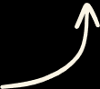
Jupyter Notebook
Python
tools
&
technologies
GitHub Repository
Libraries
(Pandas, Numpy,Matplotlib & Seaborn)
Streamlit
Streamlit Cloud
Netflix Movies and TV Shows Dataset (Kaggle)

Slide 5


tOOLS AND tECHNOLOGIES
platform
Jupyter Notebook – for writing and executing Python code interactively
Streamlit – for deploying the project as a web app
Programming Language
Python – used for data analysis, visualization, and app development
Pandas – for data cleaning and manipulation
NumPy – for numerical operations
Matplotlib – for creating visualizations
Seaborn – for advanced and aesthetic data plots
Libraries Used
Dataset
Netflix Movies and TV Shows Dataset (from Kaggle) – contains details like title, director, cast, country, release year, rating, and type (Movie/TV Show)
Streamlit Cloud – for hosting the interactive app
GitHub Repository – for version control and sharing project files
Deployment

Slide 6


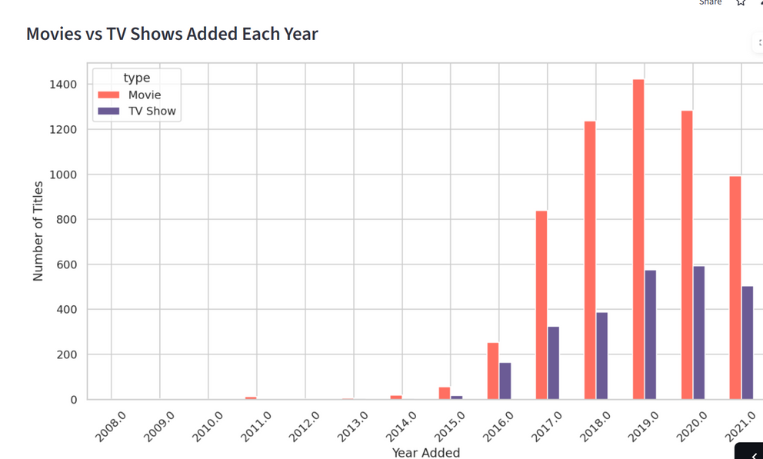
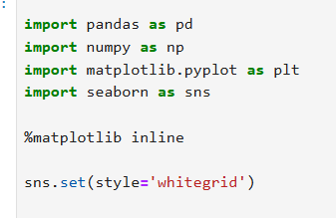
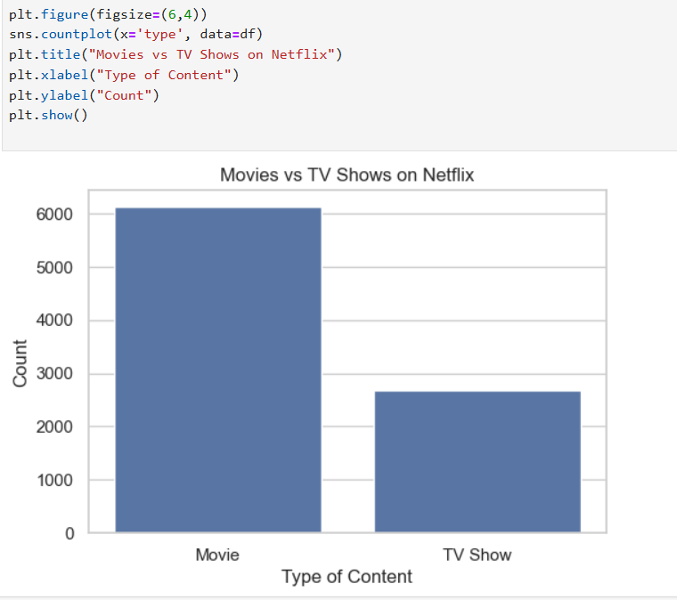
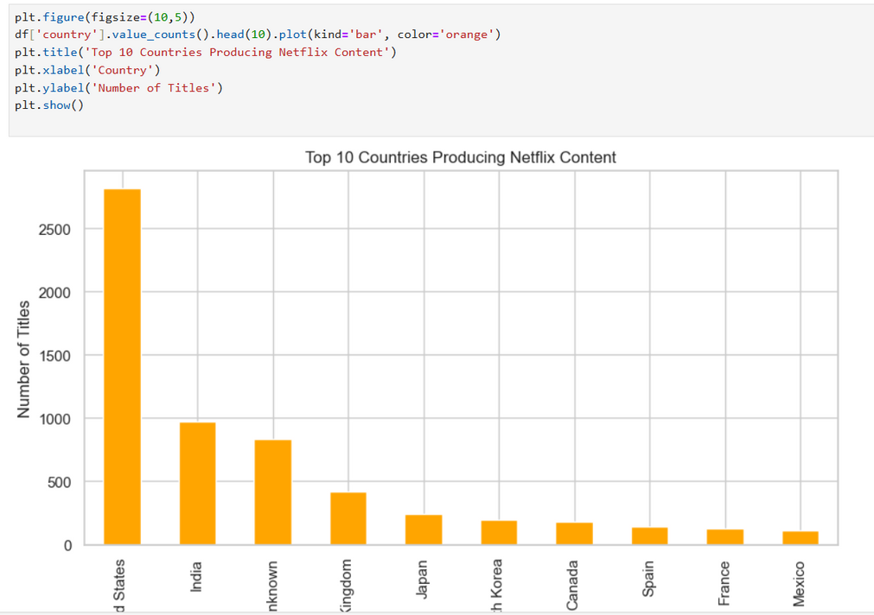
PROJECT WORKING:

Slide 7
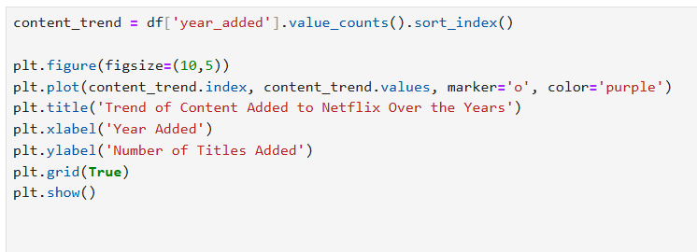
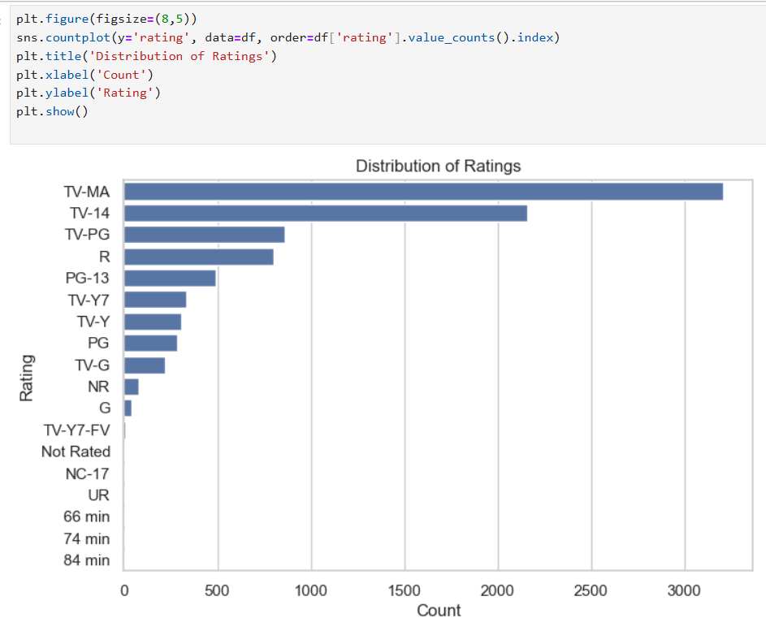
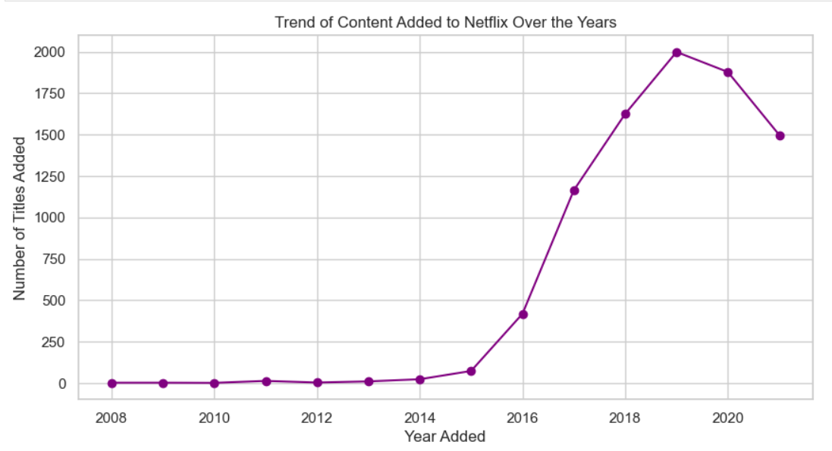


Slide 8
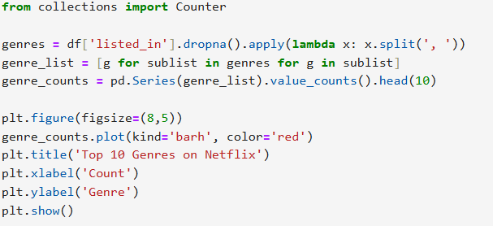
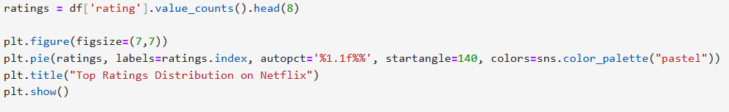
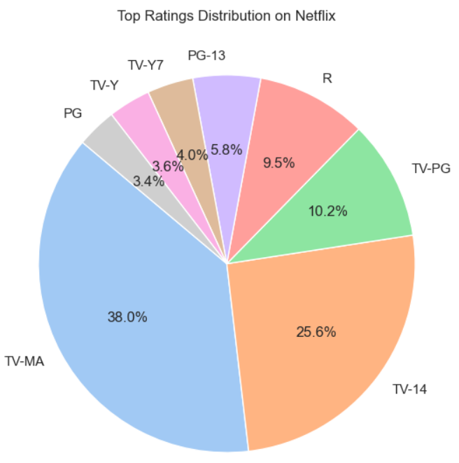
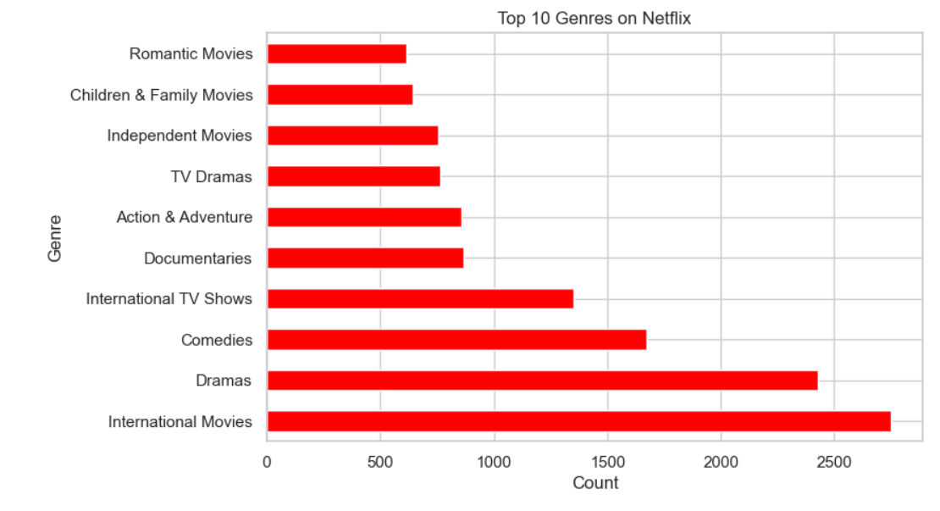

Slide 9
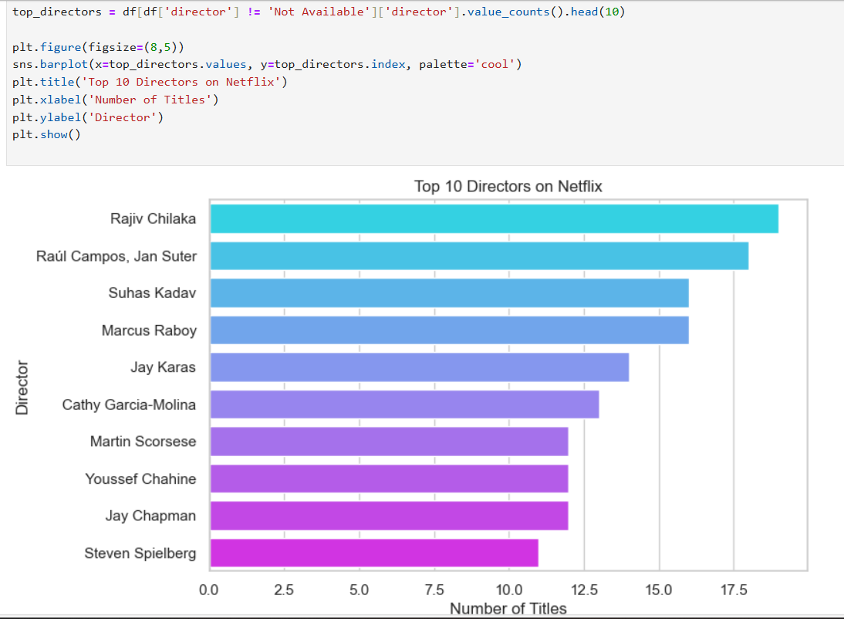
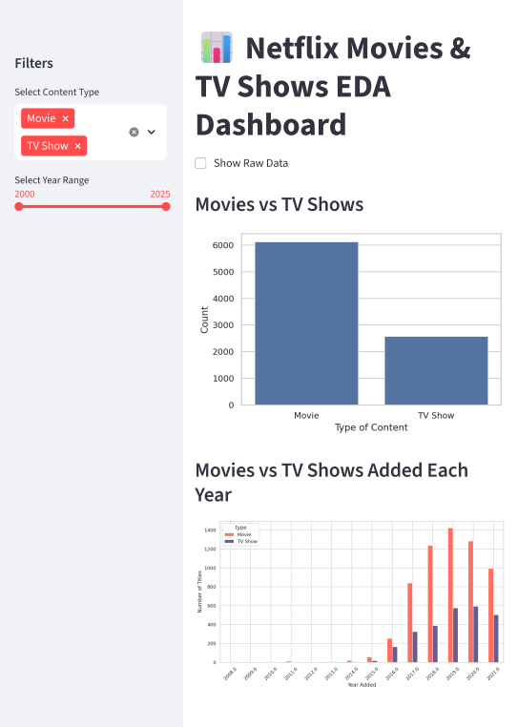
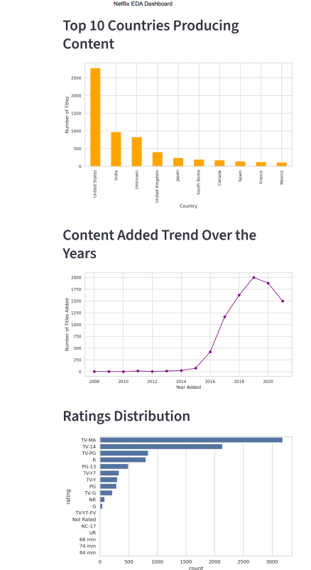




Slide 10

Applications
Content Strategy Planning: Helps streaming platforms identify trends in content type, genre, and country to make informed content acquisition decisions.
Market Analysis: Provides insights into global content distribution, helping understand which regions contribute the most to Netflix’s library.
Viewer Preference Analysis: Reveals how movies and TV shows evolve with audience demand and platform expansion.
Data-Driven Decision Making: Supports Netflix or similar OTT platforms in analyzing what type of content engages audiences over time.

Slide 11



Problems Faced and Solutions
1. Missing and Inconsistent Data
2. Irregular Date Formats
Problem: Some rows had missing values in columns like director, cast, and country.
Solution: Replaced missing entries with 'Unknown' or dropped irrelevant rows after analysis.
Problem: The date_added column had inconsistent formats.
Solution: Converted all dates using pd.to_datetime() for accurate year-based analysis.
3.Large Dataset Handling
4.DEPLOYMENT ISSUES
Problem: Difficulty in visualizing large data effectively.
Solution: Used groupby(), value_counts(), and sorting to aggregate and simplify results before plotting.
Problem: Initial errors while deploying the Streamlit app on Streamlit Cloud.
Solution: Fixed dependencies in requirements.txt and linked GitHub repository correctly for successful deploymen
4

Slide 12


FUTURE SCOPE
Machine Learning Integration: Build models to predict user preferences or recommend movies and TV shows based on viewing trends.
Advanced Analytics Dashboard: Enhance the Streamlit app into a full interactive dashboard with filters by genre, country, or release year.
Real-Time Data Updates: Integrate Netflix API or web scraping to analyze the latest content additions automatically
Deployment Expansion:Extend the project into a web or mobile dashboard for easier access and visualization.

Slide 13


PROJECT LINK
GitHub Repository URL: https://github.com/Ayanka2005/EDA-on-Netflix-Movies-TV-Shows-Dataset
Streamlit app link: https://eda-on-netflix-movies-tv-shows-dataset-devanefoxd6ga8wrrraamd.streamlit.app/

